Slide 1

Hello Powerful Choices
Greetings from
Serving: St. Croix and Pierce Counties for the past 22 years
Working to provide an affordable, decent place for all

Slide 2
Who We Are
Habitat for Humanity is an ecumenical Christian organization that works to wipe out housing inequality globally.
We accept help from anybody and everybody to serve our mission and help fight against systemic poverty through our efforts.
Through a collaborative effort between individuals, corporations, foundations, congregations, and local businesses; we engage the community at every capacity.
Created as the brainchild of biblical scholar Clarence Jordan as well as Millard and Linda Fuller in 1965- the concept of “partnership housing” was born.
St. Croix Valley serves St. Croix and Pierce County, with a history beginning in 1996.

Slide 3
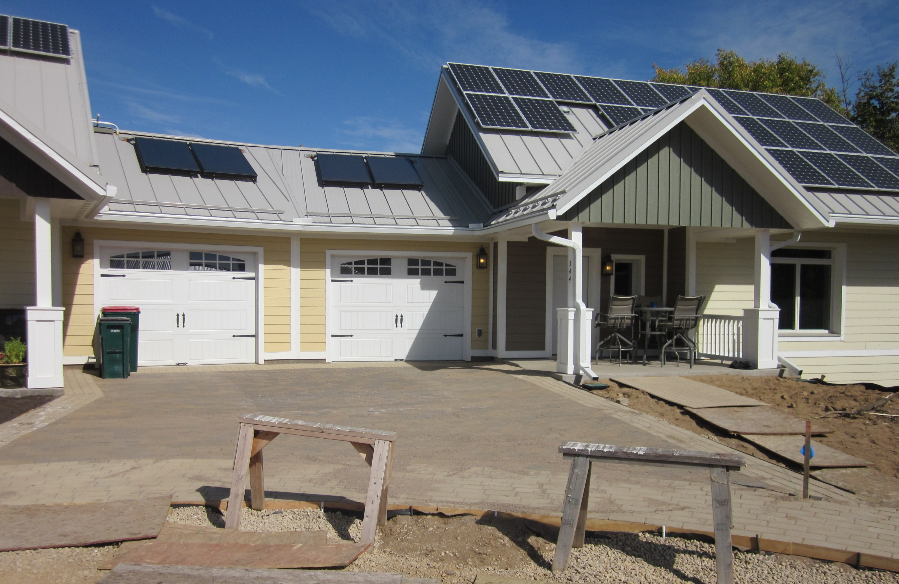
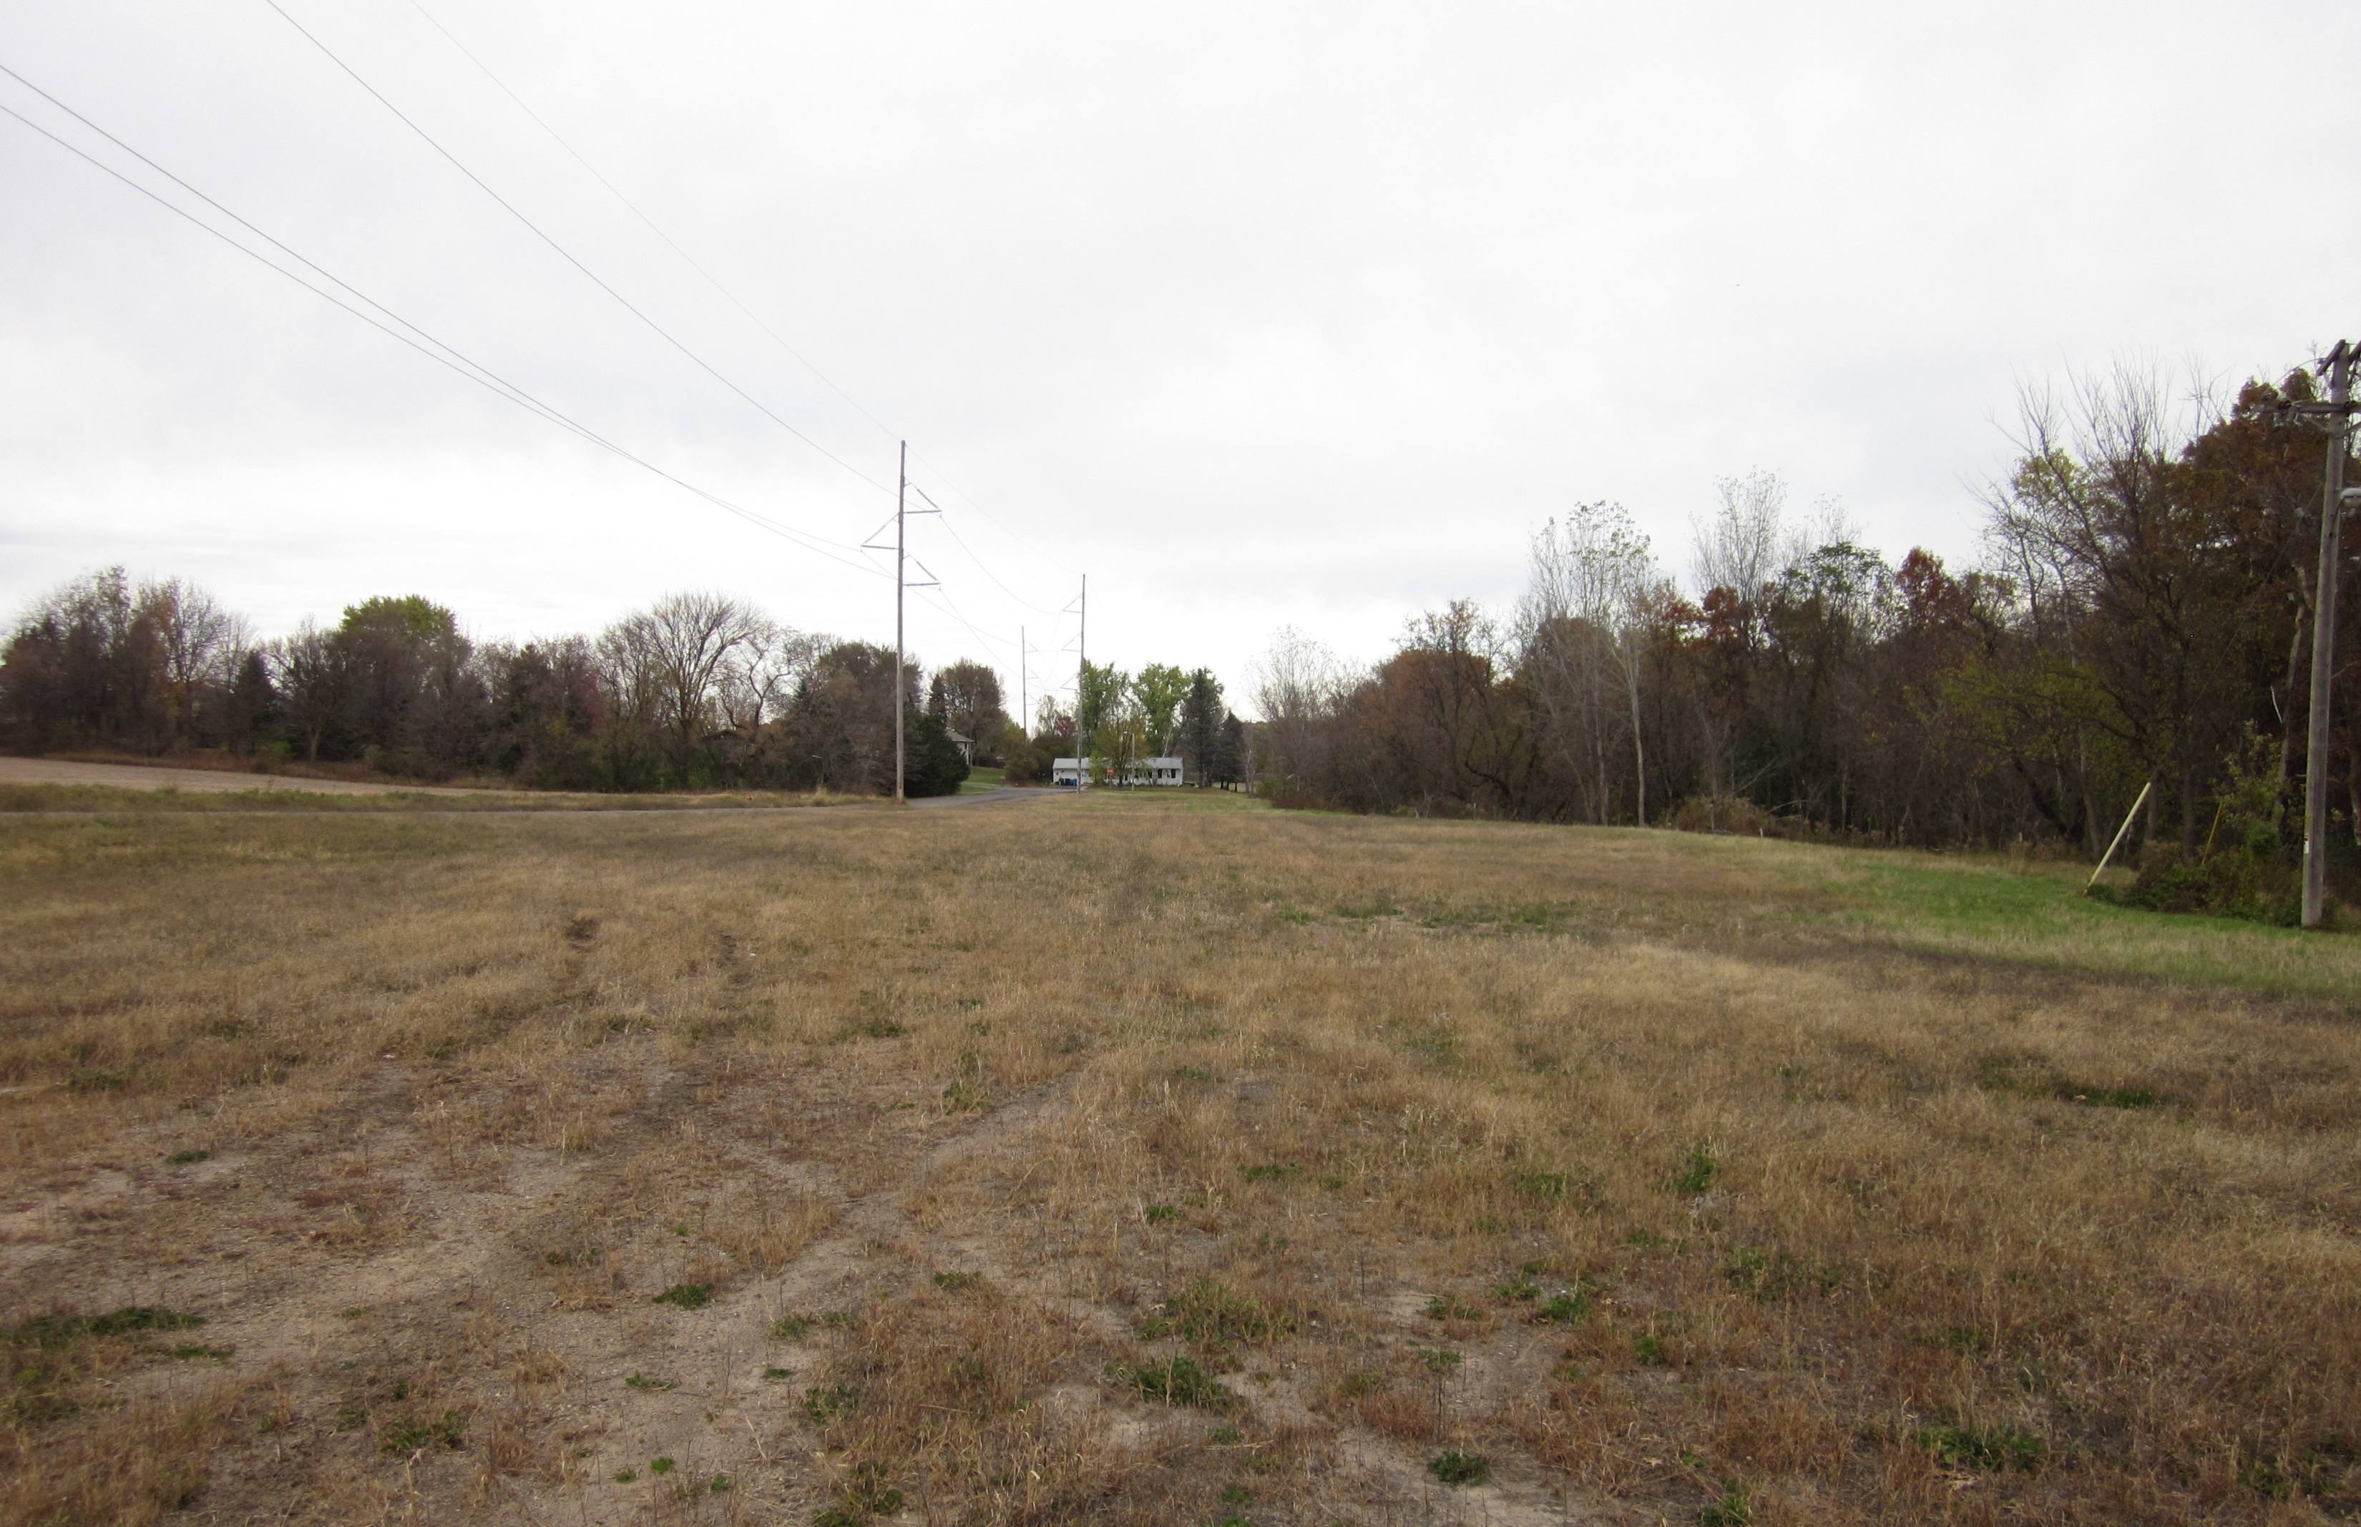
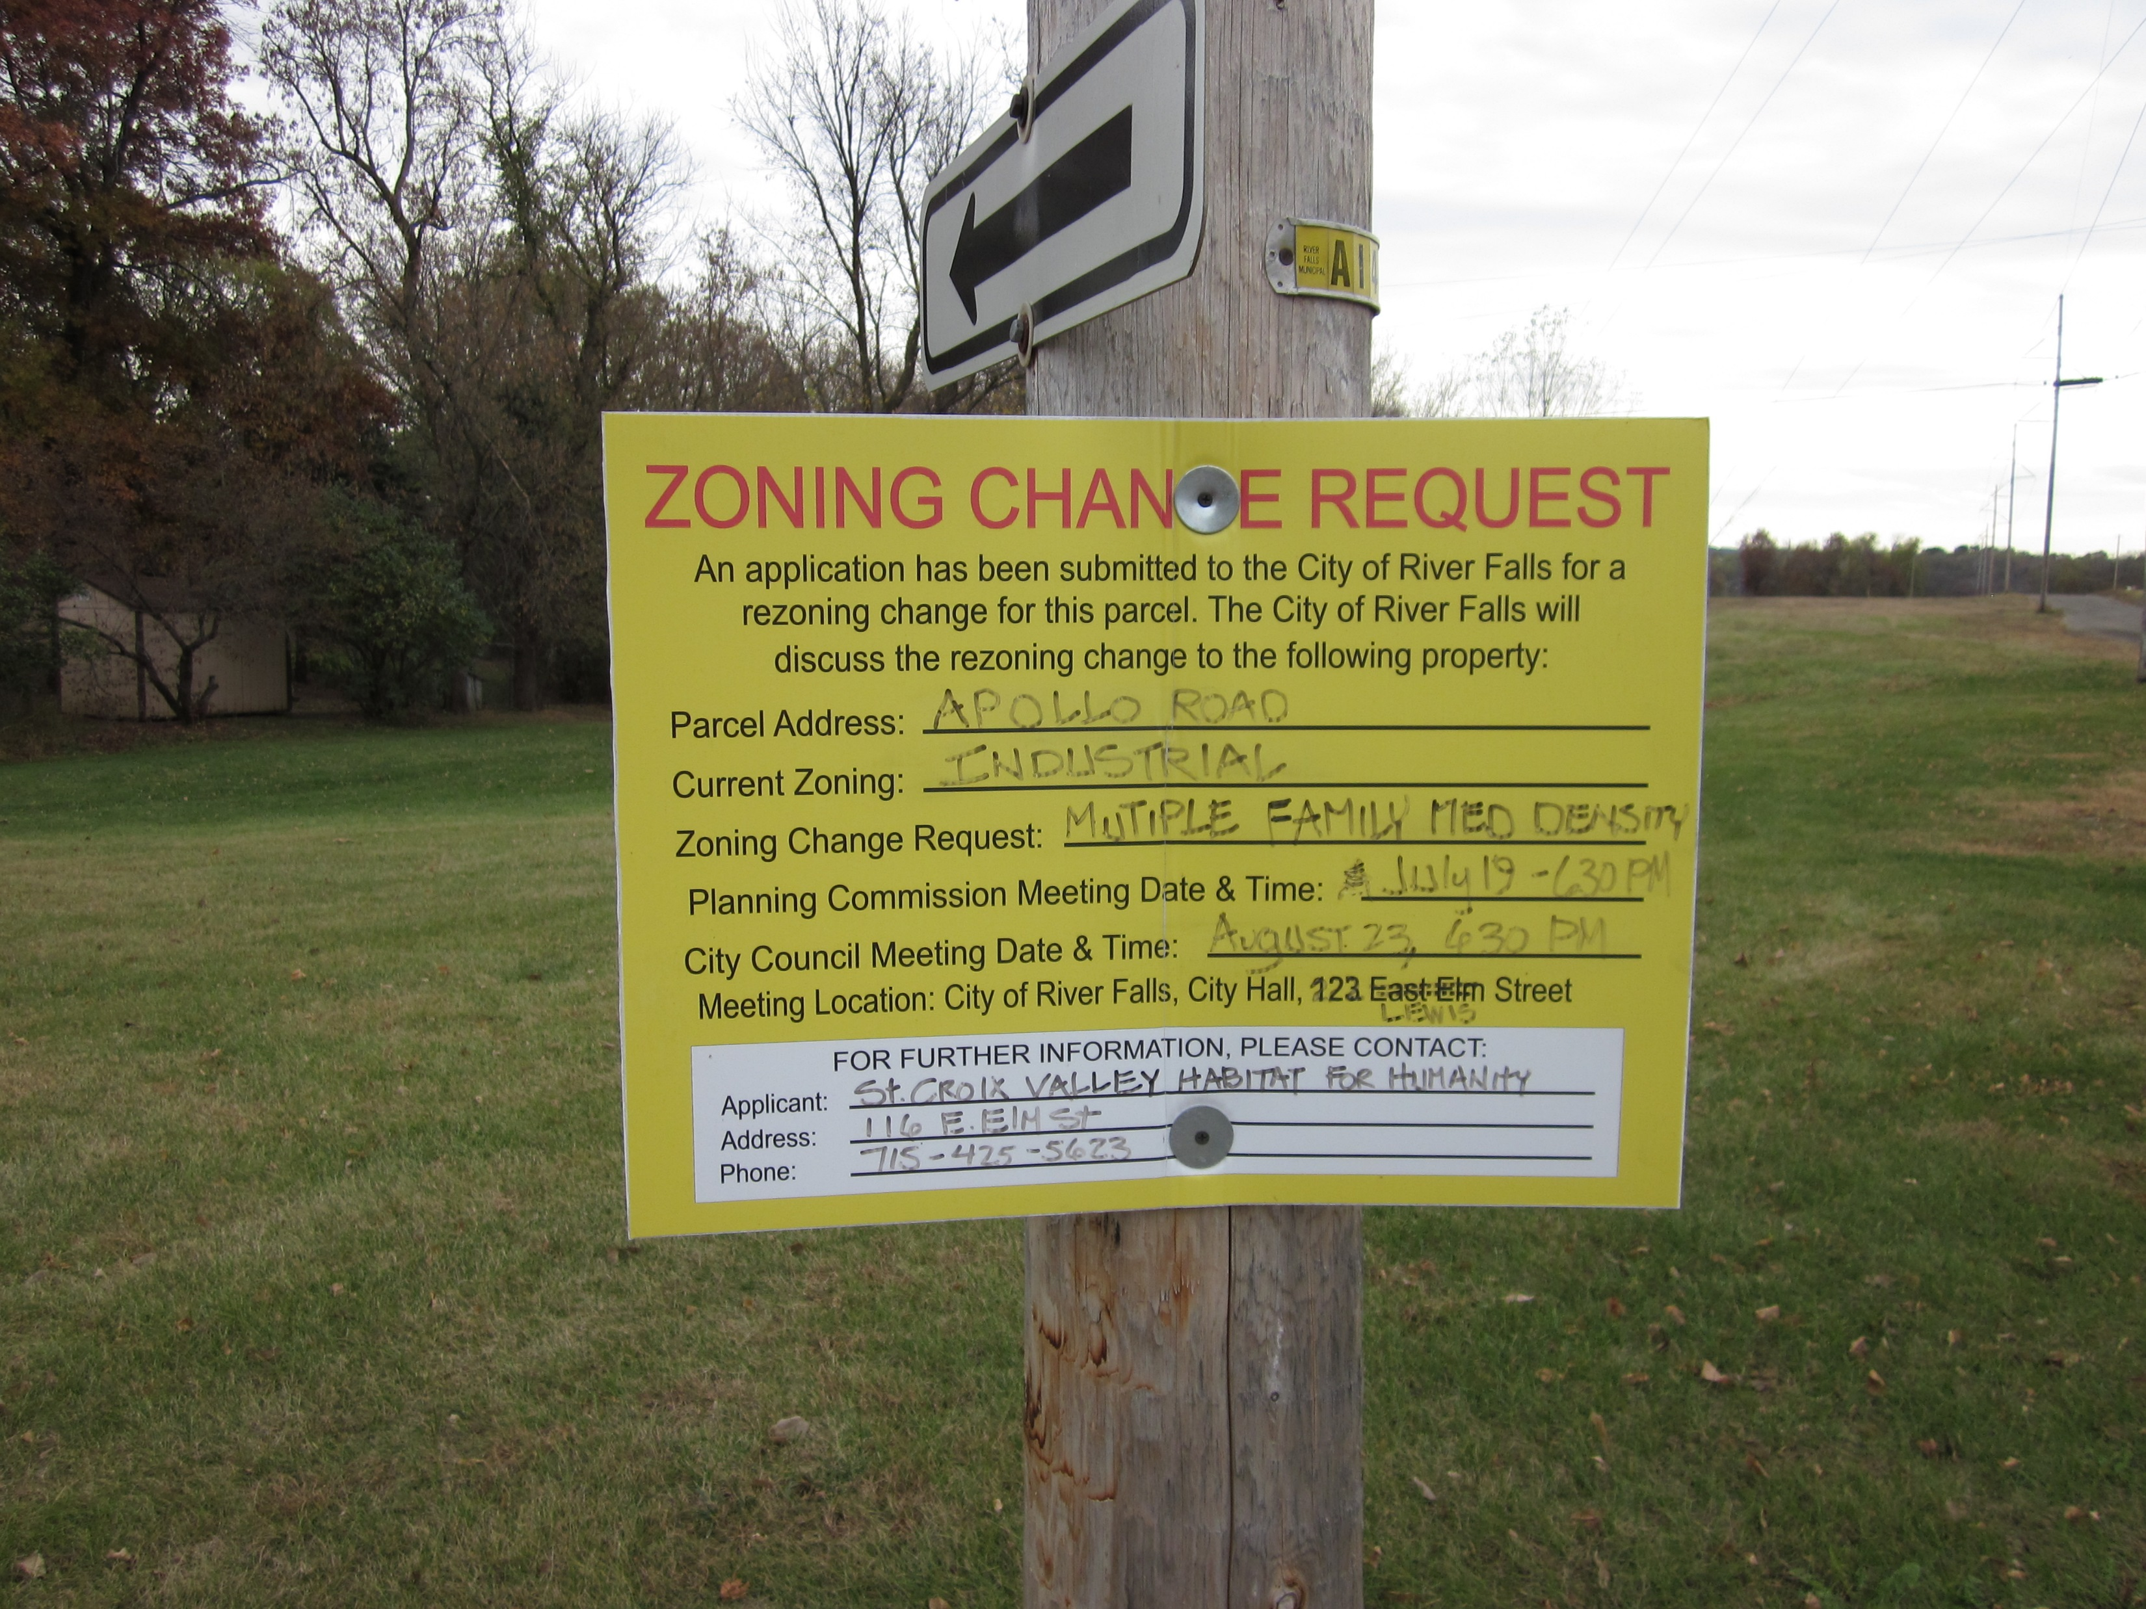
Our Past
Our affiliate has been in the St. Croix and Pierce County area since 1996.
We originally started with a concerned group of citizens in Ellsworth, WI.
Since that time we have built 67 homes and are in the process of completing our 68th.
The completion of the Eco-Village in River Falls in 2015 was one of our affiliates crowning achievements.

Slide 4
Our Commitment
Habitat is all about ensuring the growth of professional, passionate, caring volunteers in our mission.
Our mission works to provide the housing that underserved families deserve.
Material, financial, and temporal donations are the basis that we act upon.
The generosity of the community leads to higher capacity for us to perform our work, and in turn benefits us all as a community.

Slide 5
How are we related to Powerful Choices?
In 2015 Wilder Research conducted a survey of families served by Habitat for Humanity. Here is a summary of what they found:
80% of homeowners feel safer in their new homes.
Over 50% of homeowner with children said their children’s grades improved after moving into their Habitat homes.
90% said they feel better about their children’s future.
More than 80% of homeowners reported that they feel more connected to their community, and over half said they participate more in community activities.
Nearly 90% of homeowners said they feel at least “somewhat better” about themselves, and 75% feel “much better” about themselves compared to before becoming a Habitat homeowner.
Overall, 87% of homeowners used some form of government assistance at the time of application, and, at the time of the interview, that percentage declined by 20 points.
Overall, 92% of homeowners said their lives were better since moving into their home. Of those 92% who said their lives were better, 89% said they attributed that positive change either “completely” or “a lot” to Habitat.
Our mission is unmistakable in the good it provides our community and will continue to do so far into the future.

Slide 6
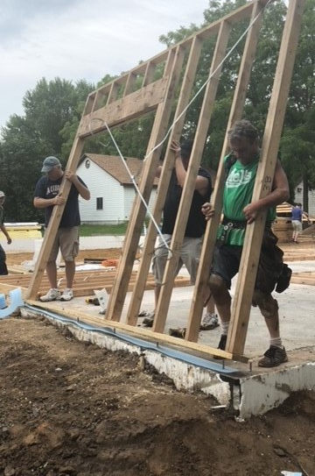
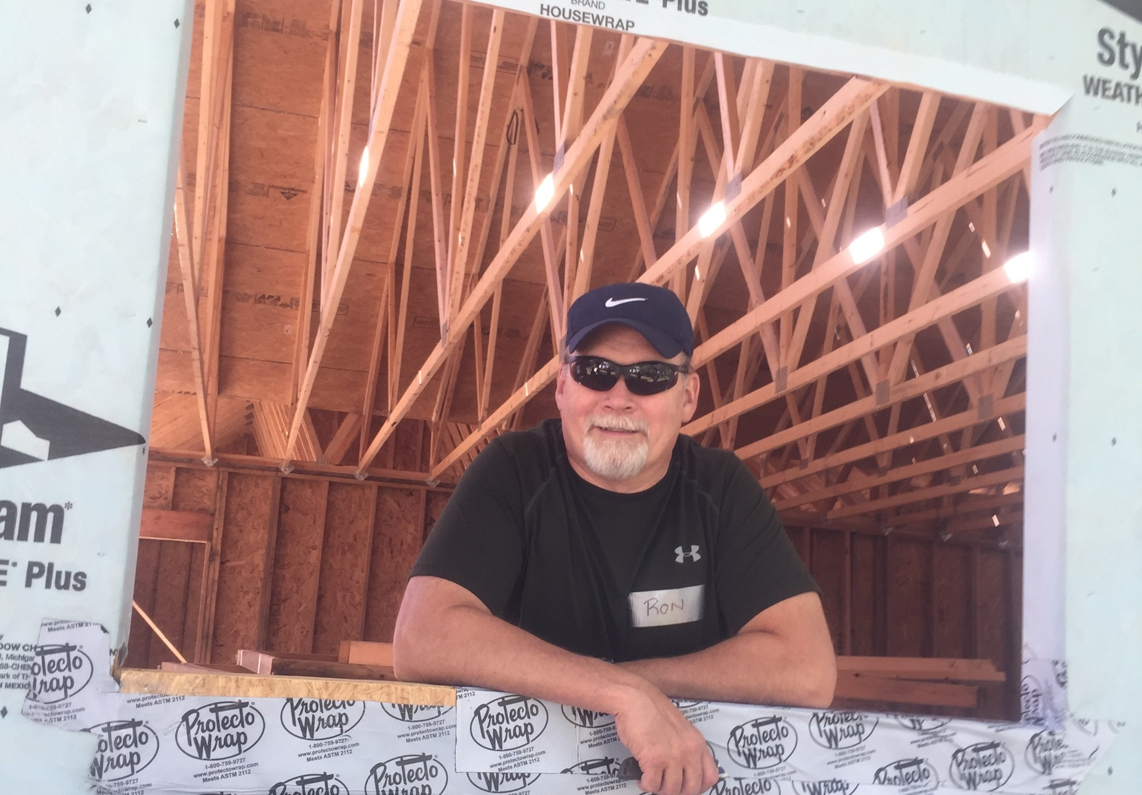
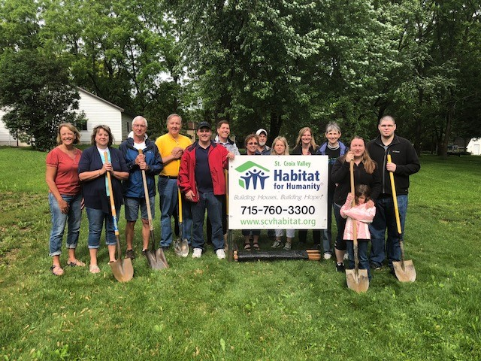
Our Present
SCVHFH is in the middle of building our 68th house in Hammond, WI.
Specifically, we are finishing the siding before the freeze sets in, and then moving inside to start the interior work aka drywall, tiling, etc.

Slide 7
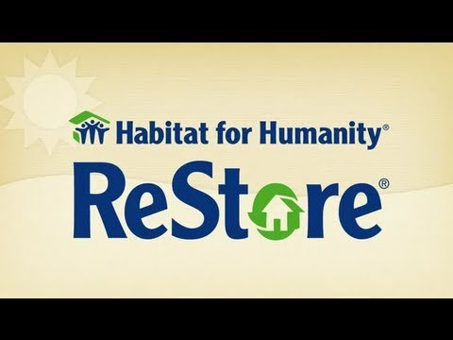

Our ReStore
A great example of how donations go a long way towards making our mission a reality. All proceeds get funneled back into our mission work too!

Slide 8
Our Programs
House Builds | A Brush With Kindness | Aging In Place
Every year we partner with at least one Partner Family to build 1-2 houses a year. Each Partner Family member contributes 250+ “sweat-equity” hours to the construction of their new home. Volunteers, material donations, and grant money are vital in helping us finish each house. | A program adopted by Habitat International, this program is designed to help with small-scale home repair. It is geared towards the elderly, the physically disabled, and those adversely affected by life circumstance. | Similar to A Brush With Kindness this one is specifically tailored towards assisting the elderly with small-scale home repair.

Slide 9
Volunteer Opportunities
We offer service opportunities for all from the basic to the skilled.
No knowledge is needed to help us build, it can all be taught in a safe, fun environment.
Remodelers, Home Builders, Handy people, General Contractors, Electricians, and Plumbers are just a few of the professions that make up the backbone for our construction process.
Other professions such as administrative work, coding expertise, event planning, volunteer coordination, are all part of our work as well.
Our ReStore offers donation receiving, repair, and inventory stocking.
Habitat believes in embracing the work of all to benefit the many.

Slide 10
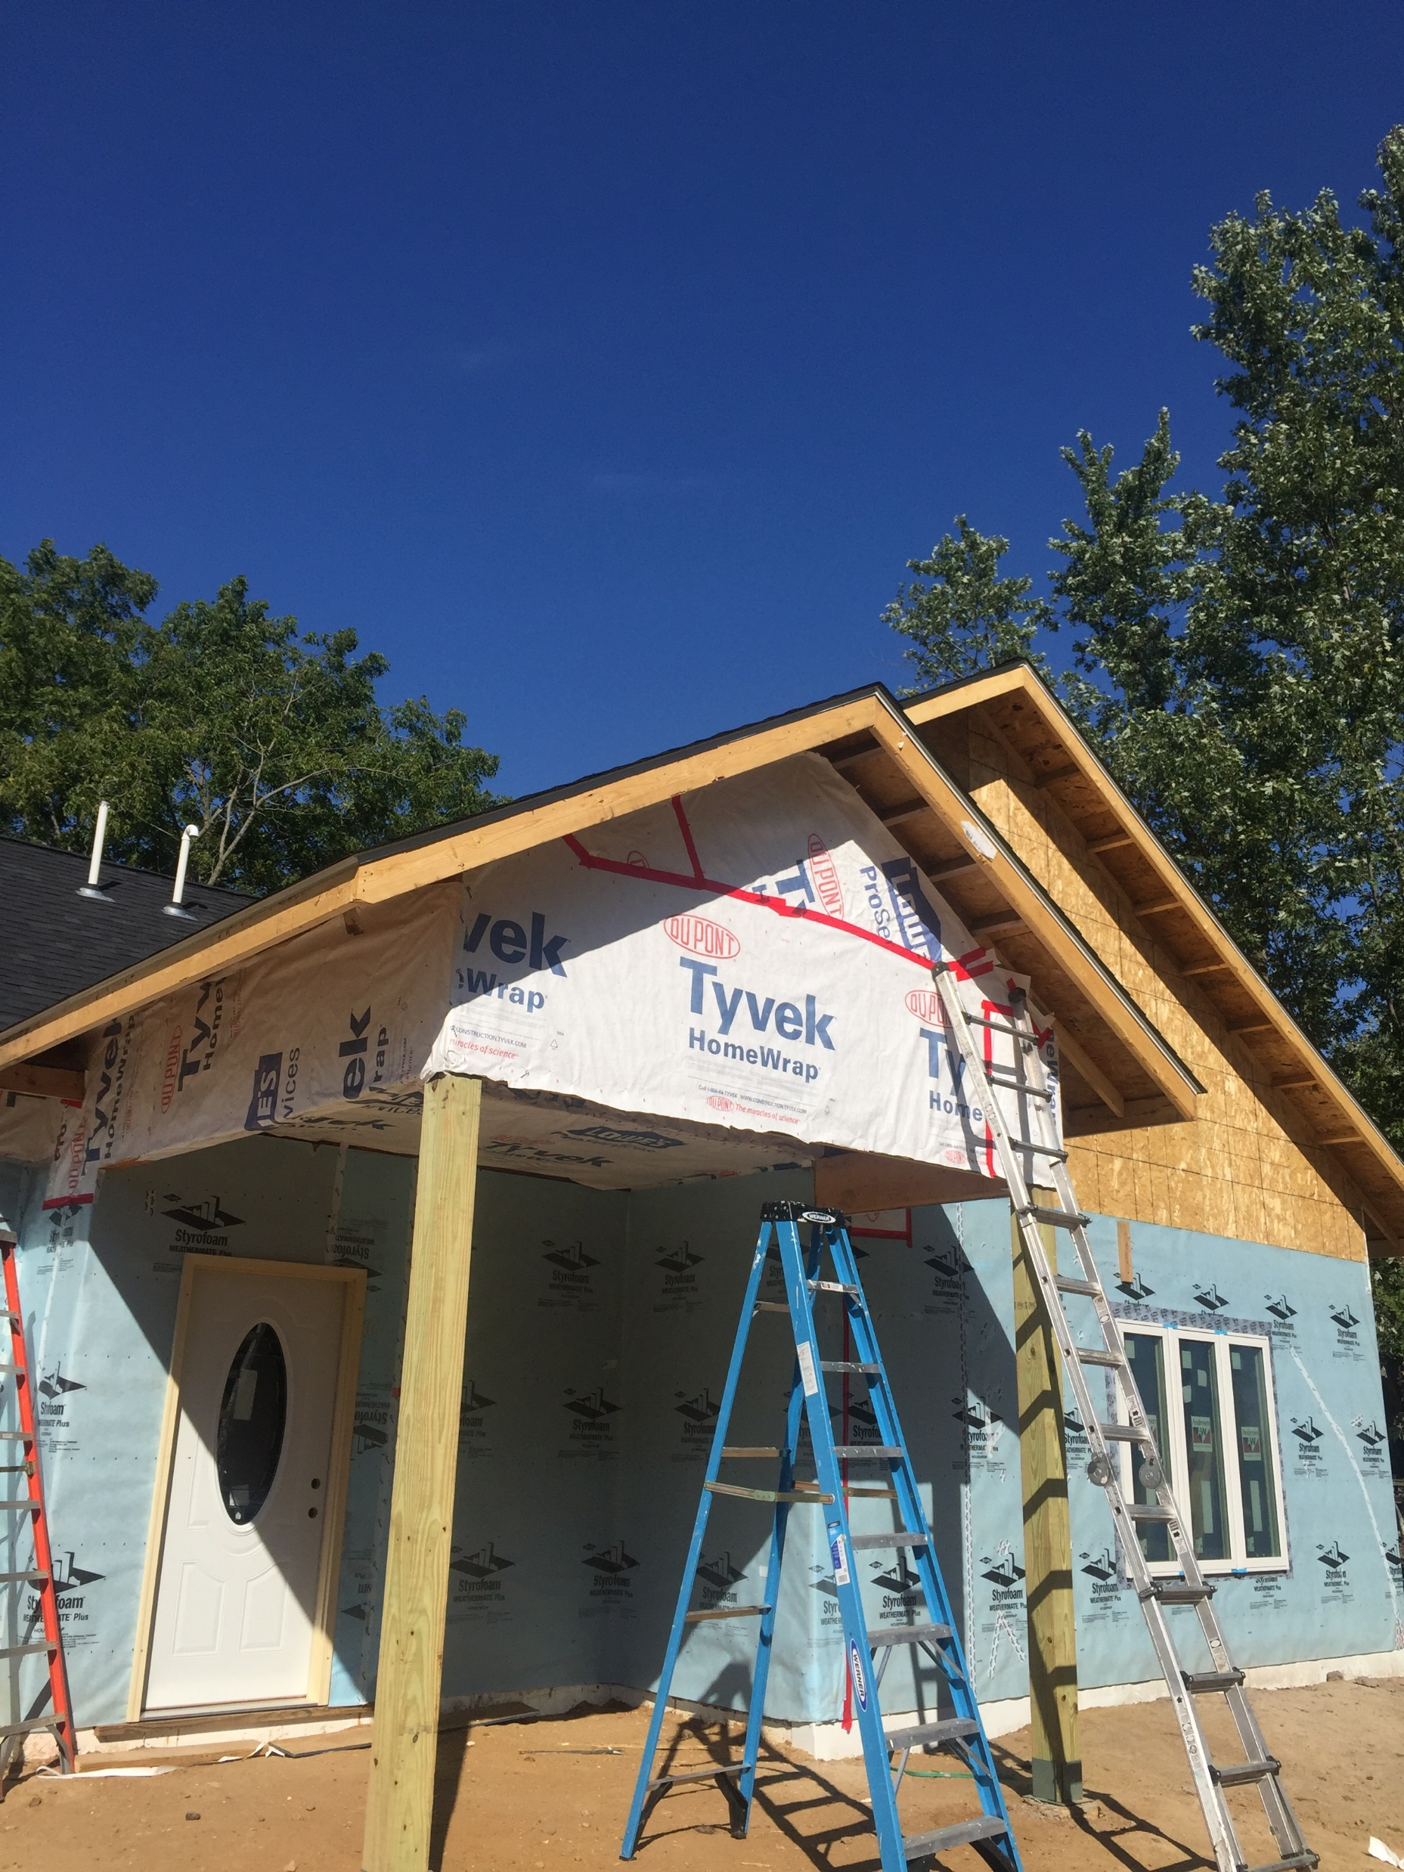
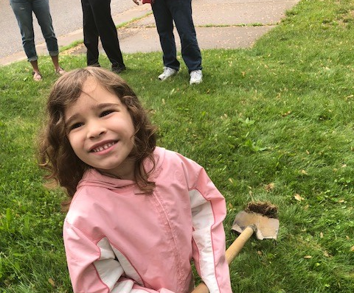
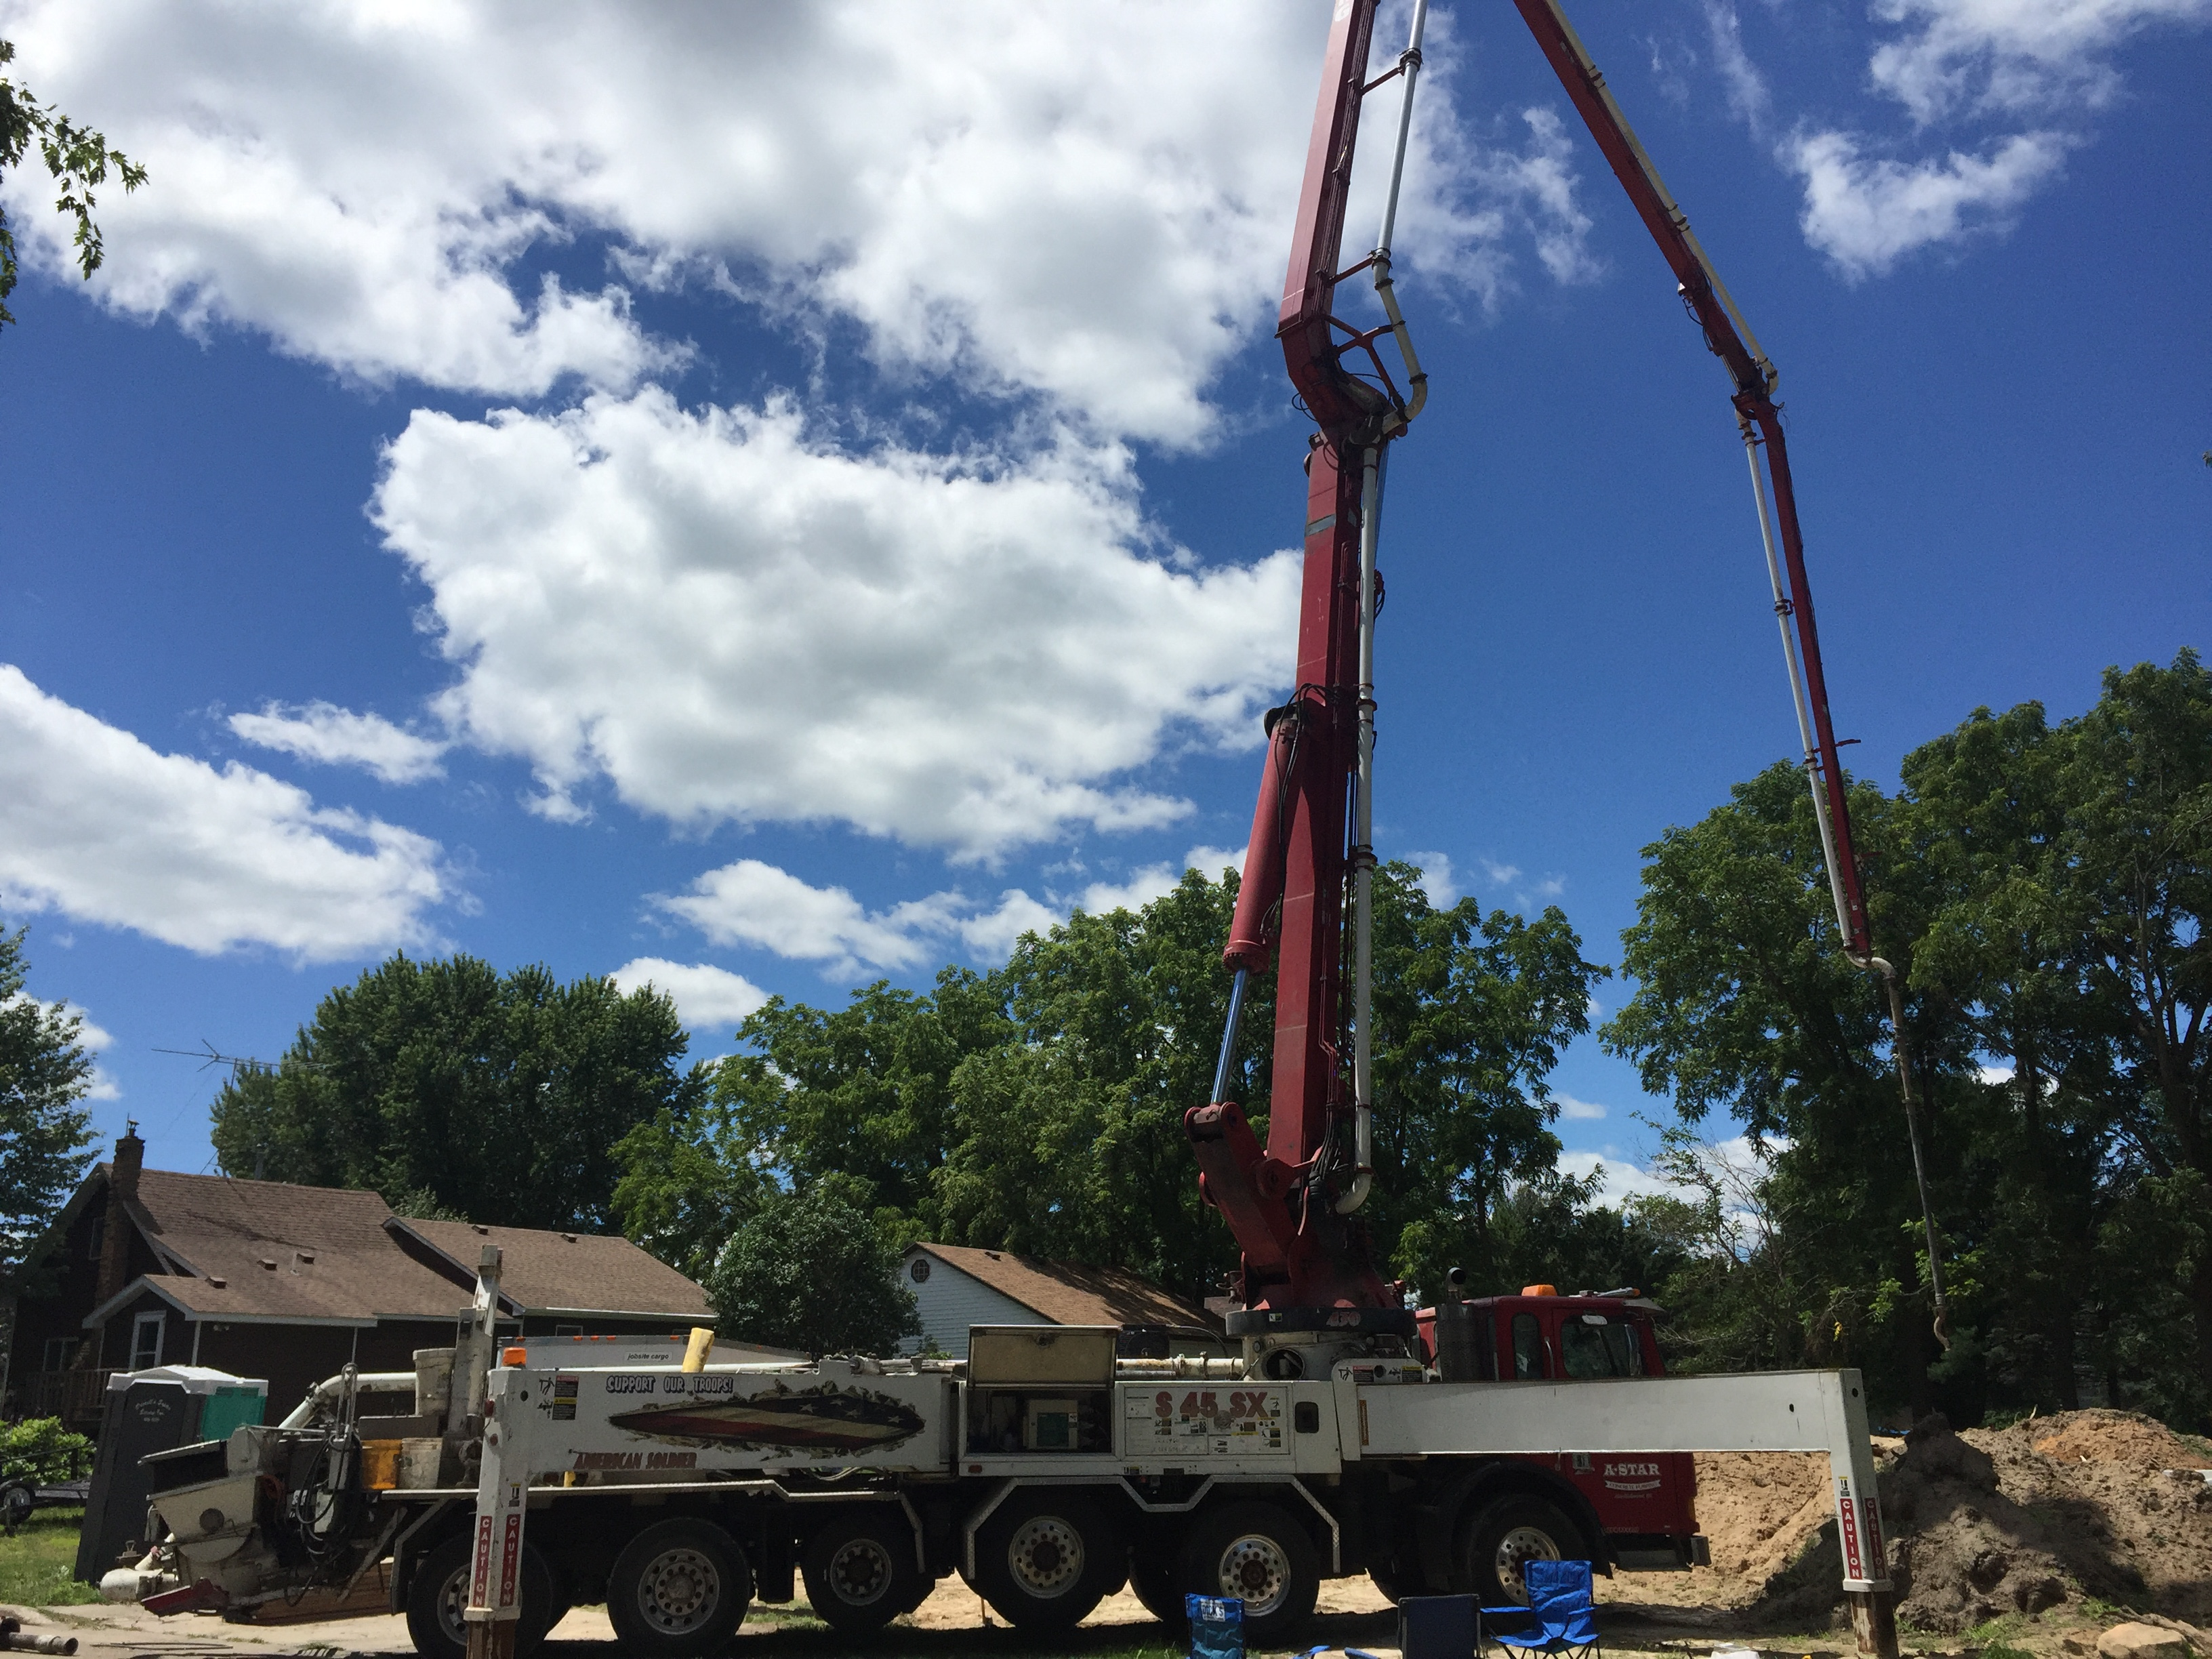
Our Future
We are sworn to continue our mission work to see a world without homelessness.
In 2019, we are planning on doing two rehabs in Hudson and Baldwin, as well as planning for a tentative build in New Richmond.
We are also planning tentative projects for A Brush With Kindness and Aging in Place.

