Slide 1
Brandon Patterson
Term Project
Biomass Development
FORY 5480
Auburn University

Slide 2
Project Goals
Determine areas of availability suitable for biomass development in the state of AL
Could lead to job development for many towns
3 criterion are involved
Cities with a large size population
Access to the highest potential for biomass development
Infrastructure in place to transport harvested biomass

Slide 3
What is Biomass
Biomass is any plant life which can be harvested for energy purposes which is also renewable
Data includes hardwoods and softwoods in the state of Alabama
Highly desired in the field of energy for both burning in energy plants as well as possible conversion to gasoline
Counts as a “green” source because of its renewability

Slide 4
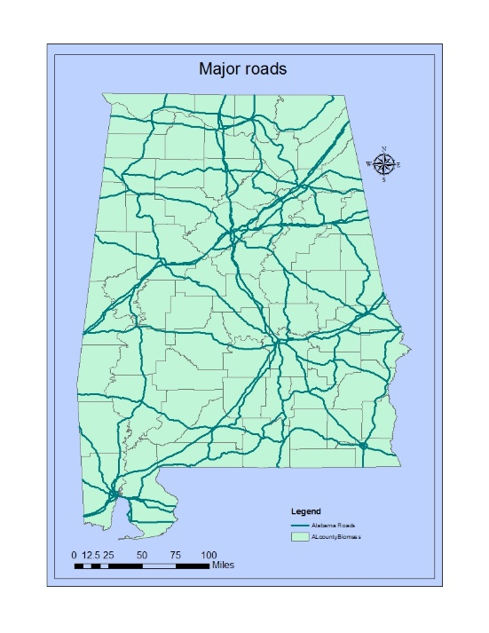
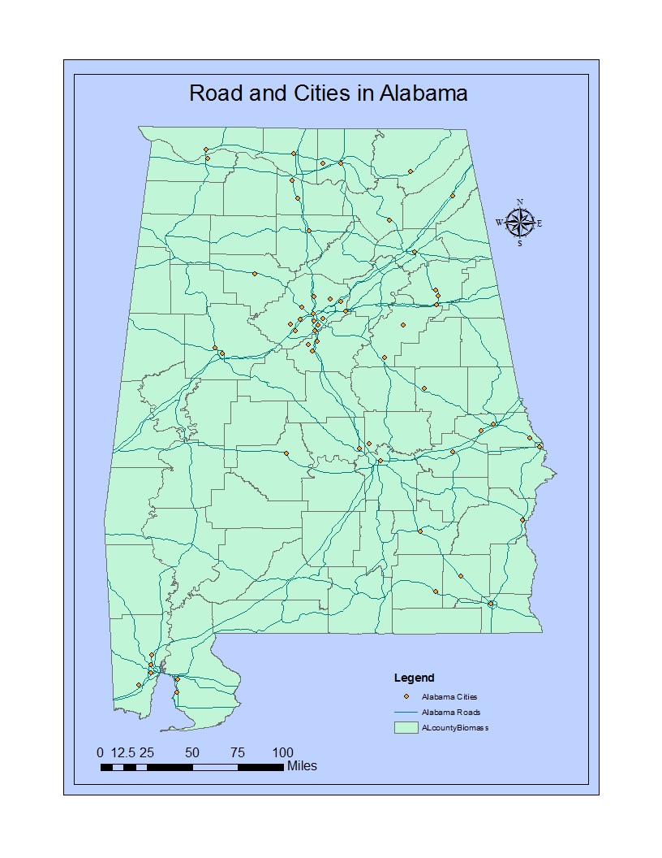
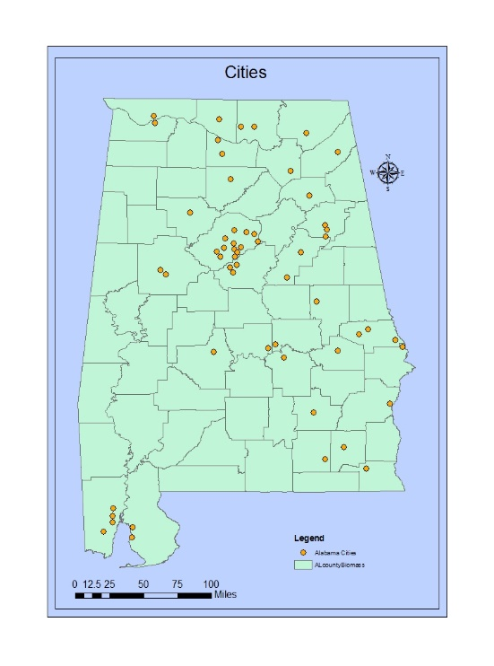
A Brief Overview
Map of the cities and major roads in Alabama

Slide 5
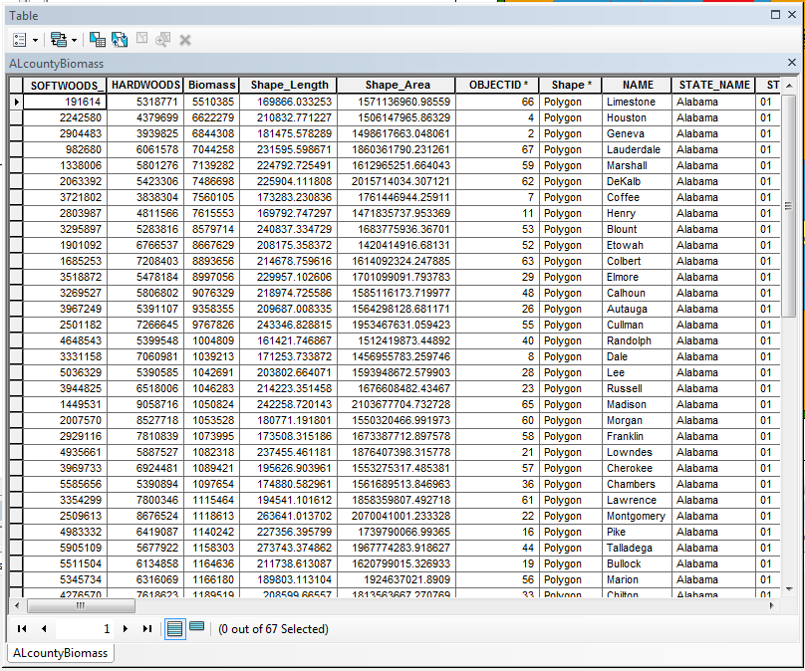
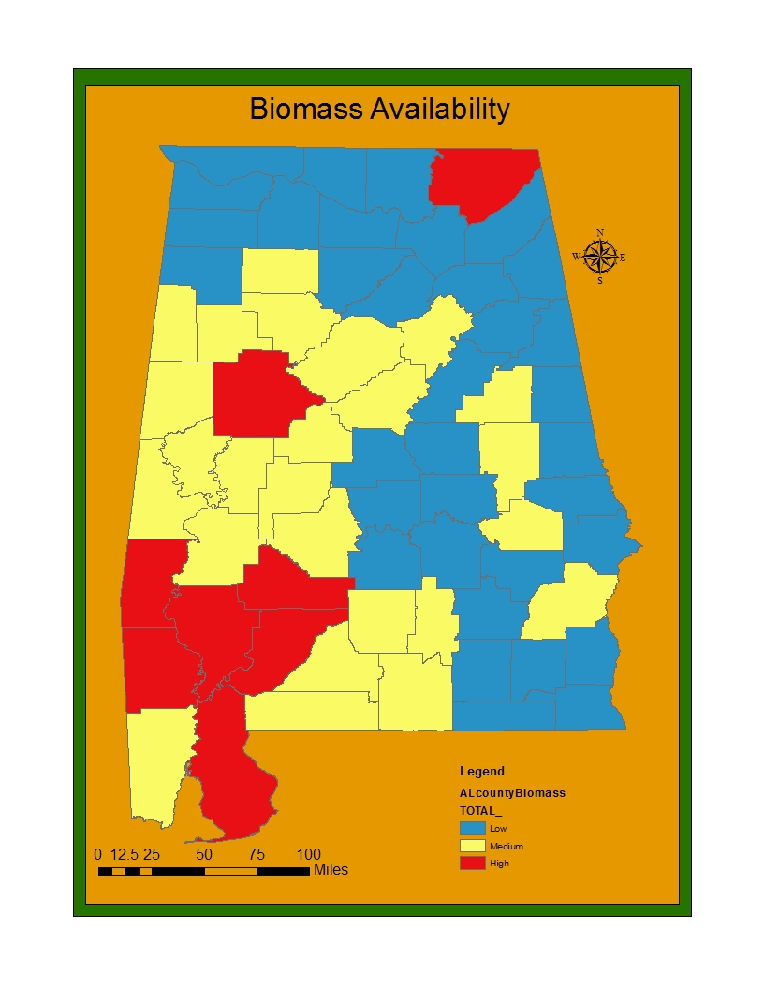
Biomass availability rank
Developed through reclassification

Slide 6
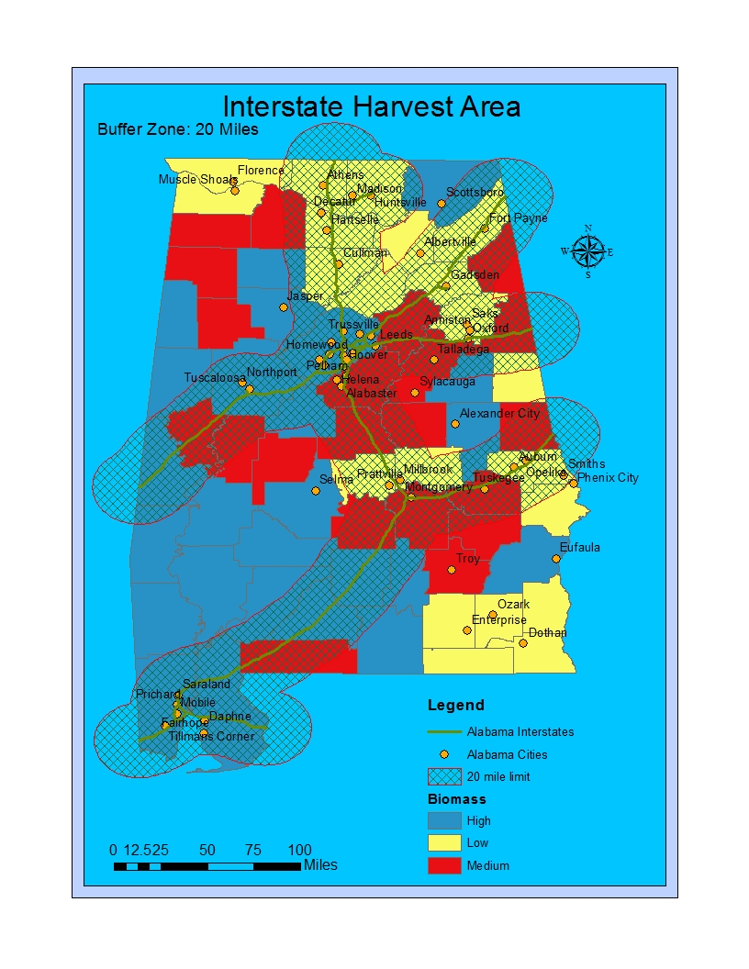
Infrastructure
Infrastructure is needed to provide roads for transport for the biomass available spots to efficiently reach the best hubs of market
The map on the right is an example of a buffer placed to delineate the areas of harvest available within 20 miles of interstates which are the fastest way to transport biomass product

Slide 7
Biomass Availability
Biomass is widely available in the state of Alabama
The map provides an accurate ranking system based on the counties in the state of Alabama
A reclassification of the hardwoods and softwoods totals was used to create a map ranking of the counties

Slide 8
City Population
Population size of cities and towns are vital for correct analysis
Job openings would become available from the correct formula of high biomass availability, followed by high population with land to develop on, as well as good access to interstates most of all
Conjecture can only be provided on the actual possible of development in the near future
The bigger markets are concentrated in Birmingham, Mobile, Montgomery, and Huntsville as the cities with the largest populations in Alabama
They would more be more of the selling point with some hybridization for possible development depending on the biomass harvest potential around some in the central part of the state
Montgomery is in a very good area for development based off the 20 mile buffer zone

Slide 9
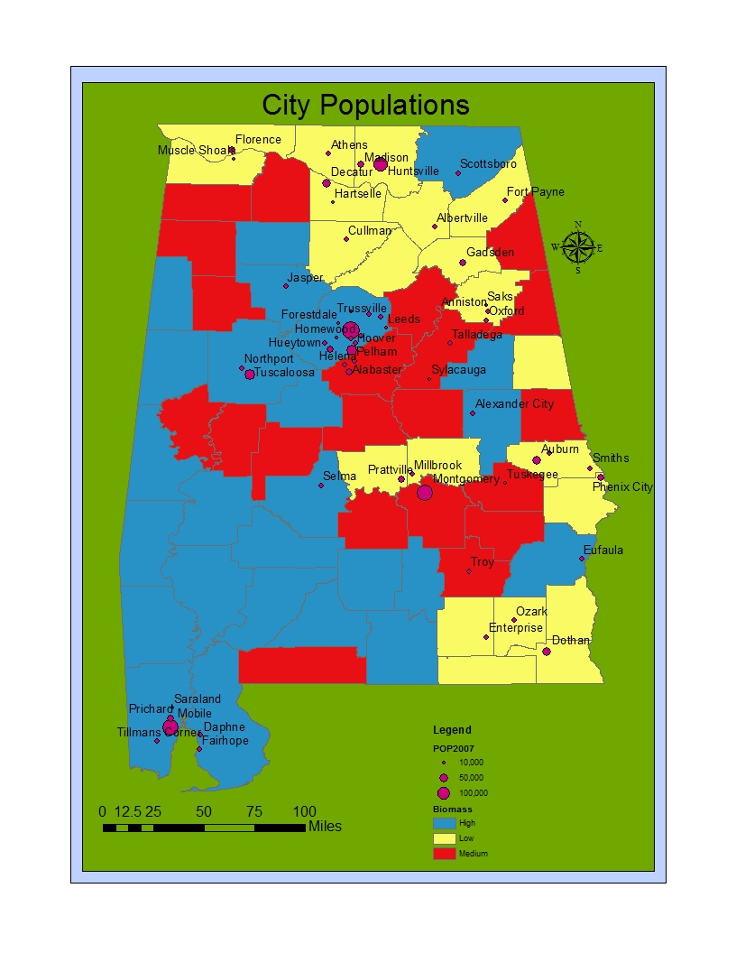
A proportional symbol map to provide an easy reference for city populations on a scale along with the base map to compare best places of development with both good populations and high potential for biomass harvest

Slide 10
Spatial Challenge
The best solution to decide which cities are within the appropriate harvest range is by the number of cities which are closest to each interstate accomplished by a spatial analysis which is performed using a select by location proximity analysis on the cities with the highest population
The interstate solution is best for most efficiency but the other roads do provide access to areas of high harvest that lie outside of the easy solution
The biomass availability map serves as a base map for comparison purposes

Slide 11
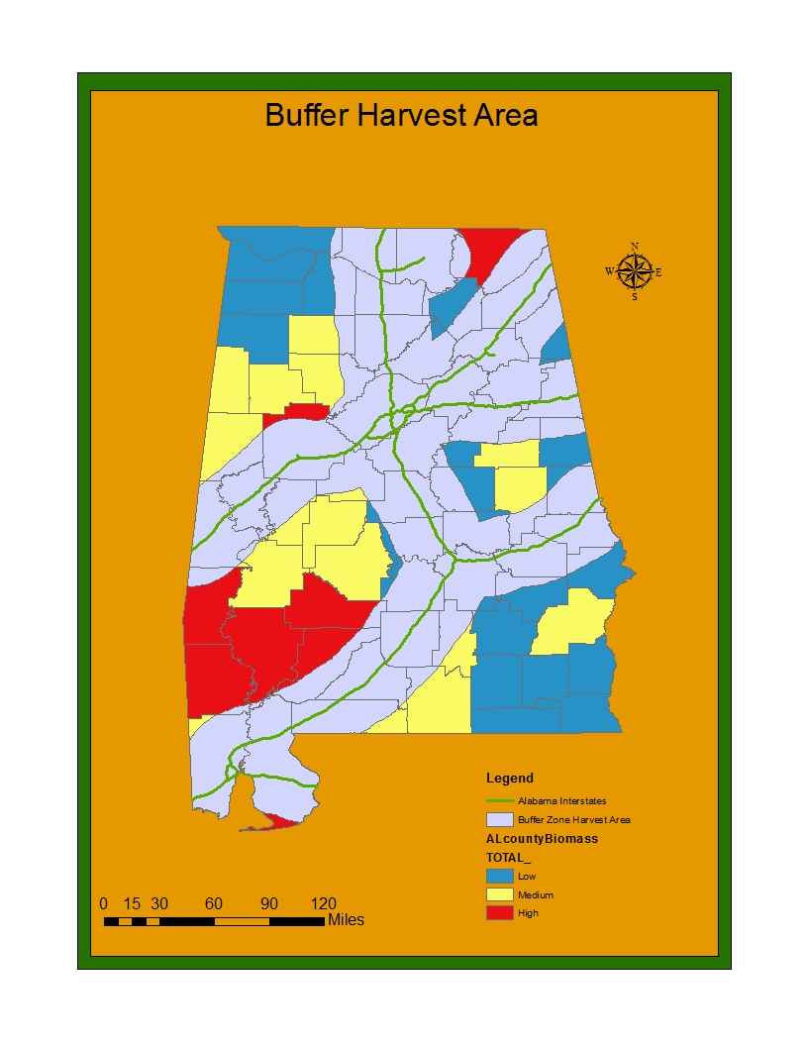
Buffer area of 20 miles and the counties that intersect the radius from the biomass availability

Slide 12
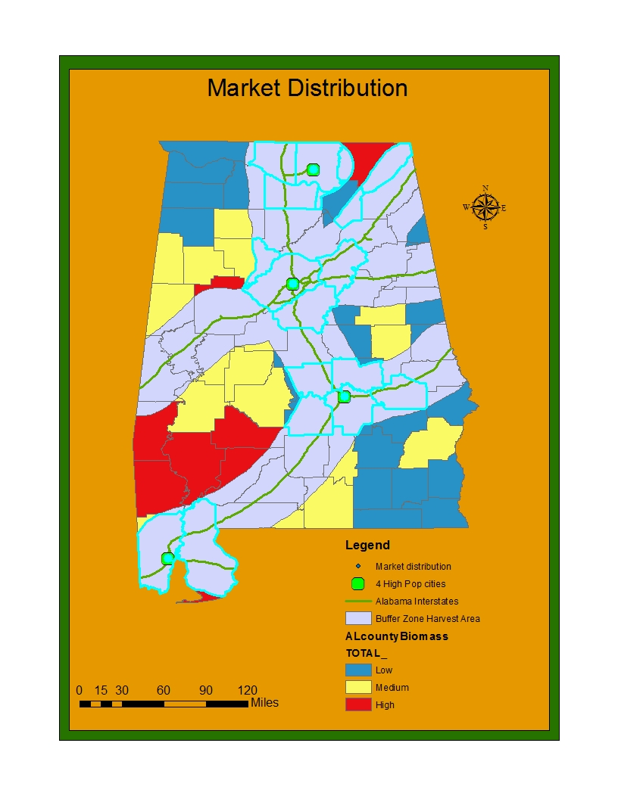
Using a select by location parameter of the four cities with the highest population in Alabama which also fall within the 20 mile buffer limit
Montgomery
Birmingham
Mobile
Huntsville
All would serve as distribution centers

Slide 13
Conclusion
Many areas are possible to develop with either high biomass potential, good access to move product, or a medium-high population for job development
There is already quite a bit of development going on in the state, however there are still areas that could stand to be harvested to continue the process of biomass production as it will more than likely be needed in the near future
Biomass is used in a lot of pursuits, and it is also a renewable energy source as research is being done into it for fossil fuels
Montgomery, Birmingham, Mobile, Huntsville, would all serve as distribution centers with easy access to the interstate
Sections above the Mobile area, to the east of Birmingham, and the northeast of Huntsville provide the best areas for high biomass potential, easy access to infrastructure (for Mobile that includes auxiliary roads), and high population centers for job growth and development

Slide 14
Functions Used
Reclassification used to develop a ranking system for biomass availability from the biomass layer
Buffer zone used to delineate areas of harvest within 20 miles of an interstate
Intersect used to join the biomass ranking layer with the buffer layer to meet two of the criteria
Select by location used as a form of proximity analysis for the four cities with the highest population in the state in order to meet the third criteria of high population

Slide 15
References
Maribeth Price dataset
Biomass data from previous years
http://us.total.com/en-us/making-energy-better/new-energies

Slide 16
End

